Slide 1
SCP – Azure Sentinel Integration
For PCE System Events ONLY
Siew Boon Siong - illumio PS

Slide 2
Objective

Slide 3
Objective
The method covers the workaround to forward the PCE system events to Azure Sentinel
https://docs.illumio.com/core/21.2/Content/Guides/events-administration/events-described/list-of-event-types.htm
Such as:
agent.clone_detected
agent.missed_heartbeats
agent.process_failed
pce.application_stopped
user.login_failure_count_exceeded
workload.online
workload.offline_after_ven_goodbye

Slide 4
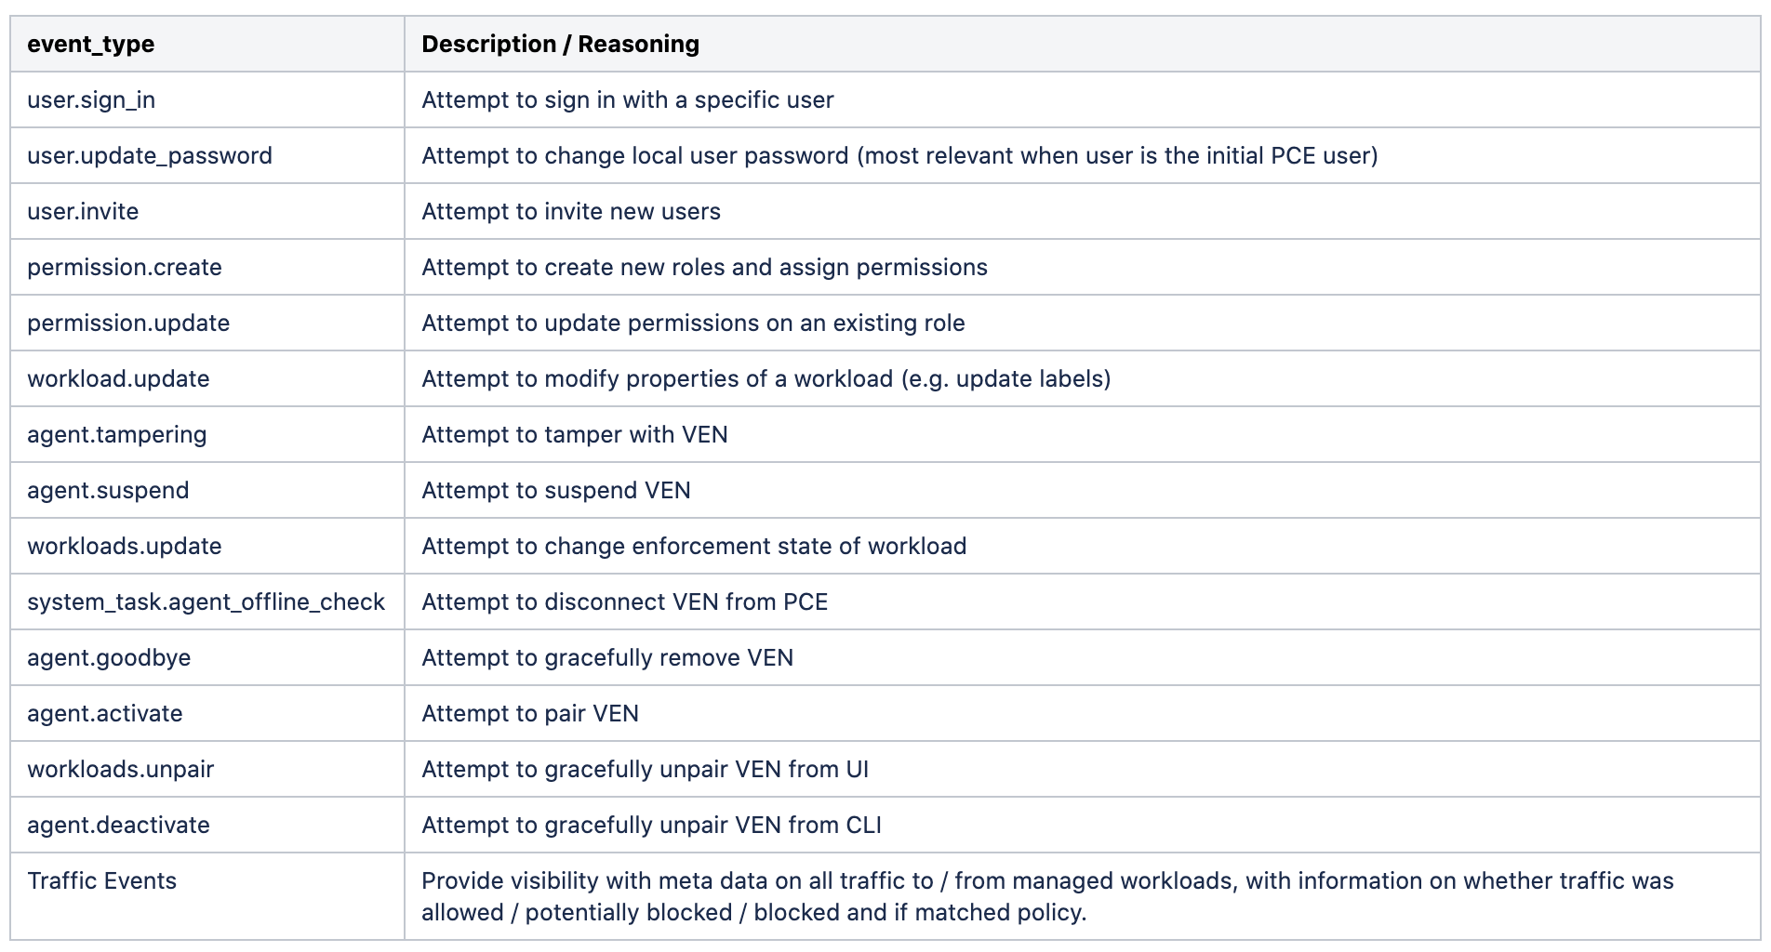
Starting Point : Events worth watching
https://docs.illumio.com/core/21.2/Content/Guides/events-administration/events-described/events-monitoring-best-practices.htm

Slide 5
Preparation – Setup Logstash

Slide 6
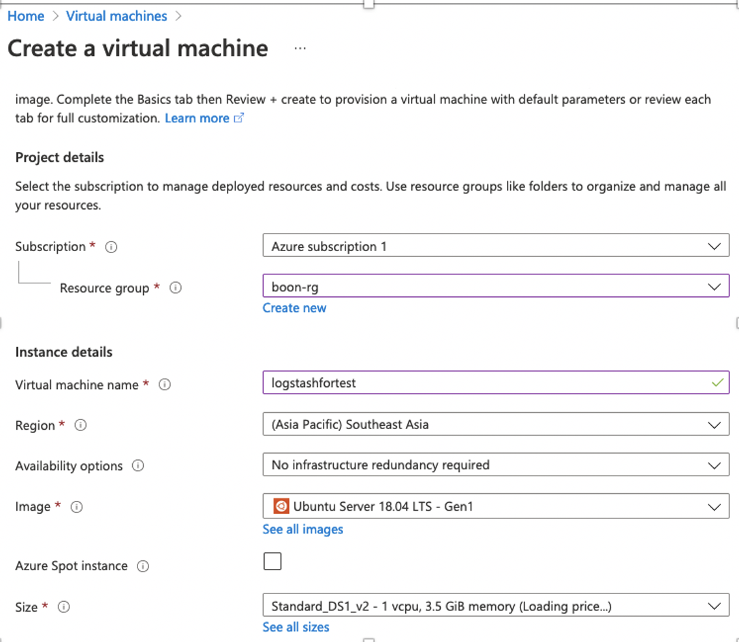
Create a Virtual Machine for Logstash
Spec tested:
Ubuntu 18.04 LTS
Size:
1 vCPU
3.5GB Memory
*Increase when needed
You can use any server.

Slide 7
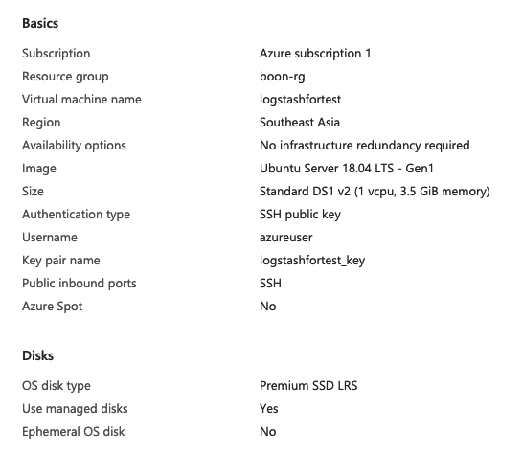
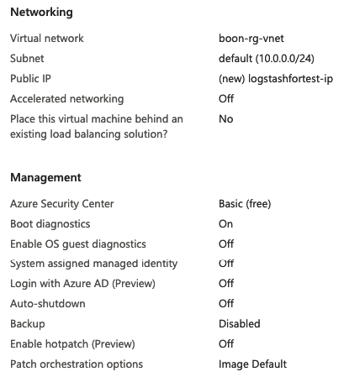
Create a Virtual Machine for Logstash (Cont.)

Slide 8
Setup Logstash
# sudo apt update
Install JRE
# sudo apt-get install default-jre
Verify Java version *version 11
# java -version

Slide 9
Setup Logstash (Cont.)
Download logstash version 7 at least
# wget -qO - https://artifacts.elastic.co/GPG-KEY-elasticsearch | sudo apt-key add –
# sudo apt-get install apt-transport-https
# echo "deb https://artifacts.elastic.co/packages/7.x/apt stable main" | sudo tee -a /etc/apt/sources.list.d/elastic-7.x.list
# sudo apt-get update
# sudo apt-get install logstash
Verify
# sudo systemctl status logstash
# sudo systemctl start logstash
Stop the application once it able to start
# sudo systemctl stop logstash

Slide 10
Preparation – Setup Azure Log Analytics

Slide 11
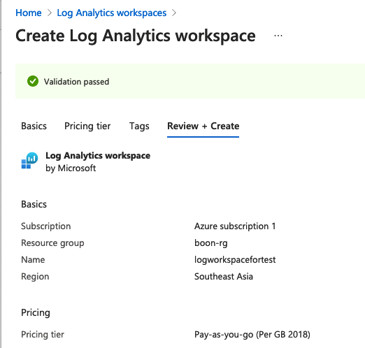
Create Azure Log Analytics Workspace
Create log analytics workspace dedicated for the logstash.
OR
You can use your existing workspace.
All we need is adding custom log table.

Slide 12
Create Custom Log – PCE System Events

Slide 13
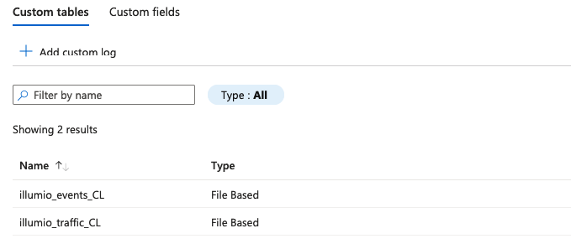
Create Custom Logs
We need to create two custom logs on the log analytics workspace.
Set two custom log name as:
”illumio_events_CL” for PCE System Event
“illumio_traffic_CL” for Traffic Data
Here’s the end result:

Slide 14
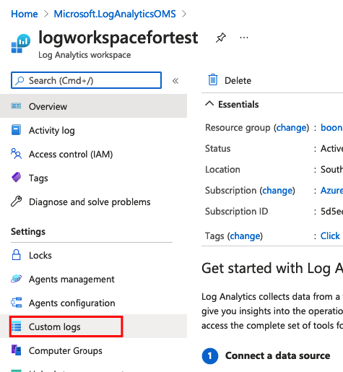
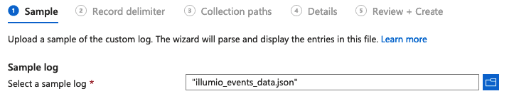
Create Custom Logs – PCE System Event
Create custom logs table.
Save the sample logs as named: “illumio_events_data.json” for initial parsing purpose:
[{"href":"/orgs/8/events/930a9027-293b-4bc0-a8b2-c3db2f83c291","timestamp":"2021-08-08T05:20:47.533Z","pce_fqdn":"scp4.illum.io","created_by":{"user":{"href":"/users/8879","username":”test@illumio.com"}},"event_type":"user.login","status":"success","severity":"info","action":{"uuid":"326e4f7a-dda0-419a-a4f7-84636831e32d","api_endpoint":"/api/v2/users/login","api_method":"GET","http_status_code":200,"src_ip":"75.1.1.1"},"resource_changes":[],"notifications":[{"uuid":"ecf7e826-a9c4-485a-9c76-6f0f8d657919","notification_type":"user.pce_session_created","info":{"user":{"href":"/users/8879","username":”test@illumio.com"}}}]}]
Upload:

Slide 15
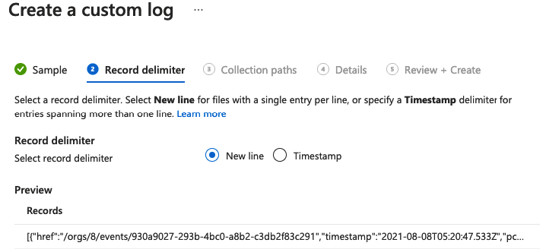
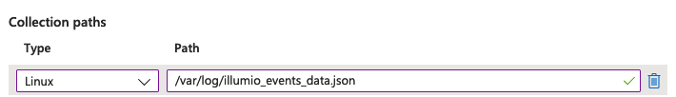
Create Custom Logs – PCE System Event (Cont.)
Select “New Line” as delimiter
Set the collection paths as /var/log/illumio_events_data.json. This is where the collection path on logstash workload.

Slide 16
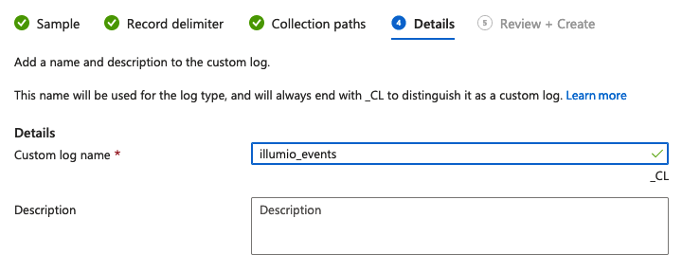
Create Custom Logs – PCE System Event (Cont.)

Slide 17
Create Custom Log – Traffic Data

Slide 18
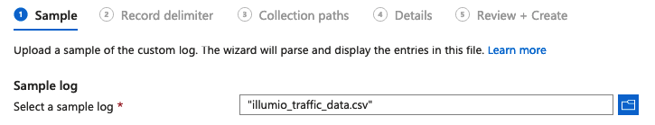
Create Custom Logs – Traffic Data
Create custom logs table.
Save the sample logs as named: “illumio_traffic_data.csv” for initial parsing purpose:
Consumer IP,Consumer IPList,Consumer Name,Consumer Hostname,Consumer Role,Consumer App,Consumer Env,Consumer Loc,Consuming Process,Consuming Service,Consuming Hostname,Provider IP,Provider IPList,Provider Name,Provider Hostname,Provider Role,Provider App,Provider Env,Provider Loc,Provider FQDN,Transmission,Port,Protocol,Providing Process,Providing Service,Providing Username,Num Flows,Connection State,Reported Policy Decision,Reported by,First Detected,Last Detected
172.16.3.100,,v19.illumioeval.com,v19.illumioeval.com,100,200,DEV,100,,,root,172.16.3.123,IPL-RFC_1918; anytest; test234,,,,,,,,Unicast,8142,TCP,,,,422,Timed Out,Potentially Blocked,Consumer,2021-08-14T00:09:18Z,2021-08-14T04:19:38Z
172.16.3.100,,v19.illumioeval.com,v19.illumioeval.com,100,200,DEV,100,,,root,172.16.3.123,IPL-RFC_1918; anytest; test234,,,,,,,,Unicast,8142,TCP,,,,89,Active,Potentially Blocked,Consumer,2021-08-14T00:04:42Z,2021-08-14T04:14:43Z
Upload:

Slide 19
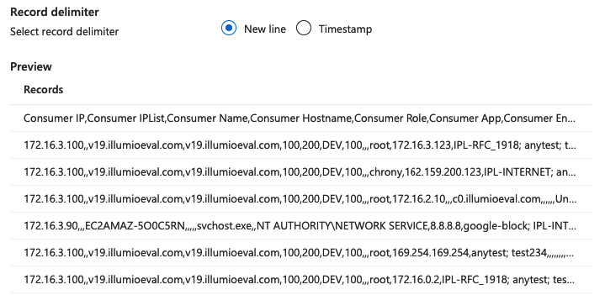
Create Custom Logs – Traffic Data (Cont.)
Select “New Line” as delimiter
Set the collection paths as /var/log/illumio_events_data.json. This is where the collection path on logstash workload.

Slide 20
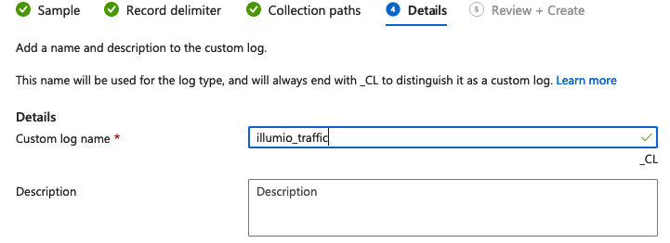
Create Custom Logs – Traffic Data (Cont.)

Slide 21
Retrieve Workspace ID and Primary Key

Slide 22
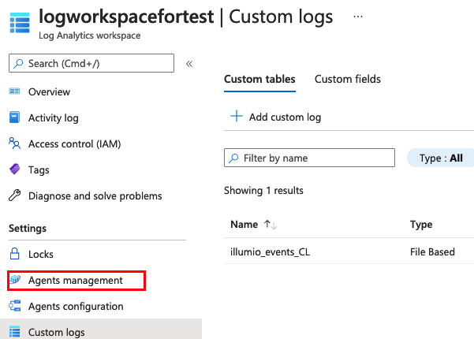
Retrieve Workspace ID and Primary Key
Go to the workspace that we created.
Settings > Agents Management

Slide 23
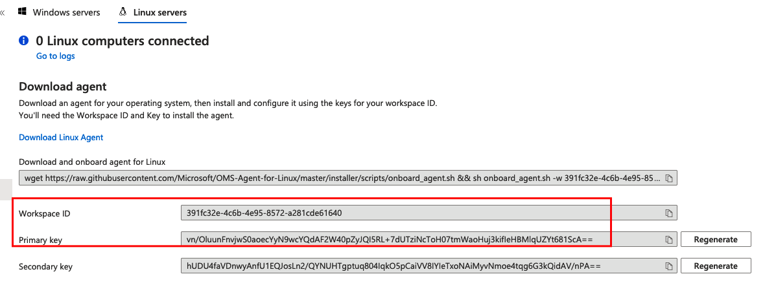
Retrieve Workspace ID and Primary Key
Click “Linux Servers”.
Copy the following information.

Slide 24
Create Logstash Config

Slide 25
Place Config on Logstash server
Back to the Logstash server, go to /etc/logstash/conf.d
Put the following config template:
*remember to replace the workspace_id and workspace_key that we retrieved
# vi /etc/logstash/conf.d/illumio.conf
input {
file {
type => "events"
path => "/var/log/illumio_events_data.json"
}
file {
type => "traffic"
path => "/var/log/illumio_traffic_data.csv"
start_position => "beginning"
}
}
filter {
}
output {
if [type] == "events" {
microsoft-logstash-output-azure-loganalytics {
workspace_id => "391fc32e-4c6b-4e95-8572-a281cde61640"
workspace_key => "vn/OluunFnvjwS0aoecYyN9wcYQdAF2W40pZyJQI5RL+7dUTziNcToH07tmWaoHuj3kifIeHBMlqUZYt681ScA=="
custom_log_table_name => "illumio_events_CL"
}
}
if [type] == "traffic" {
microsoft-logstash-output-azure-loganalytics {
workspace_id => "391fc32e-4c6b-4e95-8572-a281cde61640"
workspace_key => "vn/OluunFnvjwS0aoecYyN9wcYQdAF2W40pZyJQI5RL+7dUTziNcToH07tmWaoHuj3kifIeHBMlqUZYt681ScA=="
custom_log_table_name => "illumio_traffic_CL"
}
}
}

Slide 26
Install Azure Plugin on Logstash

Slide 27
Install Azure Plugin on Logstash
Install Azure plugin on Logstash.
Refer: https://github.com/Azure/Azure-Sentinel/tree/master/DataConnectors/microsoft-logstash-output-azure-loganalytics
# cd /usr/share/logstash/bin
# sudo ./logstash-plugin install microsoft-logstash-output-azure-loganalytics

Slide 28
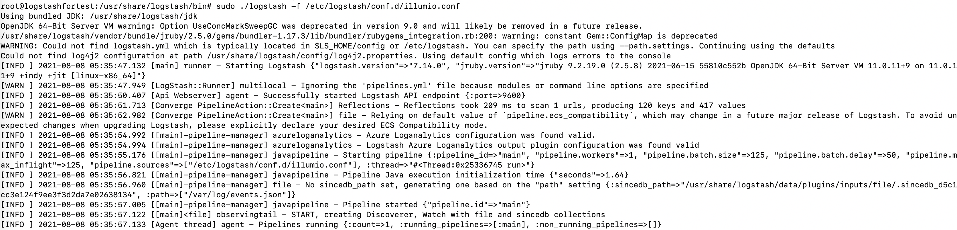
Test Run
Test run, make sure there is no error then stop it.
# cd /usr/share/logstash/bin
# sudo ./logstash –f /etc/logstash/conf.d/illumio.conf

Slide 29
Create Cron Job

Slide 30
Import Bash Scripts
Place the scripts under /var/log. Replace the API user/key, also org in the line. This script contains the API method of retrieving PCE events
#!/usr/bin/env bash
api_user='api_1e3ade09a1a5a494c'
api_key='566925c0054a2415145f7b93f341ecc1d6d3f907de64e488ee5bc65d5feabff8'
WorkingDirectory='/var/log'
ArchiveDirectory='/var/log/illumio_archive'
date_time=$(date --date="(date --rfc-3339=seconds) -10 minutes" '+%Y-%m-%dT%H:%M:%S.000Z')
if [ ! -d "$ArchiveDirectory" ]; then
mkdir ${ArchiveDirectory}
fi
cp ${WorkingDirectory}/illumio_events.json ${ArchiveDirectory}/illumio_events_${date_time}.json &>2
curl -s -X GET https://scp4.illum.io:443/api/v2/orgs/13/events?timestamp[gte]=${date_time} -u ${api_user}:${api_key} -H 'Accept: application/json' >> ${WorkingDirectory}/illumio_events.json
echo "" >> ${WorkingDirectory}/illumio_events.json
echo "${date_time} Job Run" | tee -a ${WorkingDirectory}/illumio_cronjob

Slide 31
Import Python Scripts (OR)
Place the scripts under /var/log. Replace the API user/key, also org in the line. This script contains the API method of retrieving PCE events and traffic data.
The sample script attached along.

Slide 32
Test the Script
Test the script by running manually
Start Logstash:
# sudo /usr/share/logstash/bin/logstash -f /etc/logstash/conf.d/illumio.conf
Run the bash script:
# sudo bash /var/log/illumio_sentinel.sh
OR
Run the python script:
# sudo /usr/bin/python3 /var/log/illumio_sentinel.py
We should see update on the logstash console, example:

Slide 33
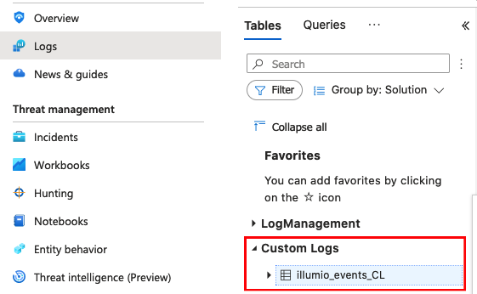
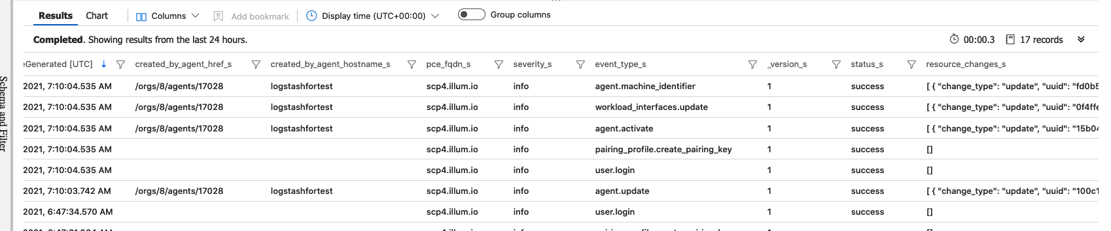
Test the Script (Cont.)
Go to Azure Sentinel > Logs > Custom Logs:
After running the query, we will be able to see the
Events:

Slide 34
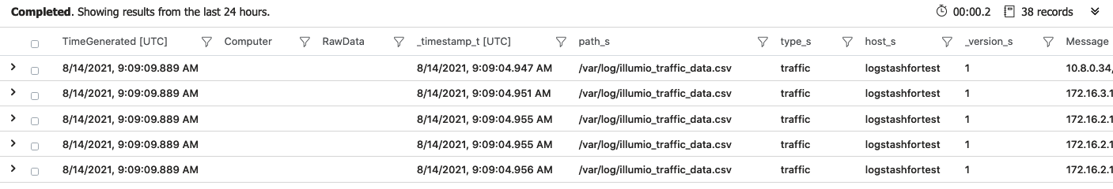
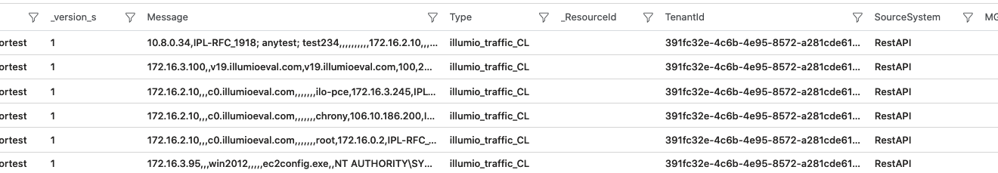
Test the Script (Cont.)
Sample for traffic data:

Slide 35
Running Script as a Cron job
1. Go back to the Logstash server, setup 10 minutes interval cron job for running the scripts.
# crontab –e
Insert:
# */10 * * * * /bin/bash /var/log/illumio_sentinel.sh >/dev/null 2>&1
*/10 * * * * /usr/bin/python3 /var/log/illumio_sentinel.py
2. Monitor /var/log/syslog , we should see the cronjob running every 10 minutes.
3. Set the Logstash command running in background
# sudo /usr/share/logstash/bin/logstash -f /etc/logstash/conf.d/illumio.conf
Press CTRL+Z
# bg
To check the job with command
# jobs
# ps –aux | grep logstash

Slide 36
Info

Slide 37
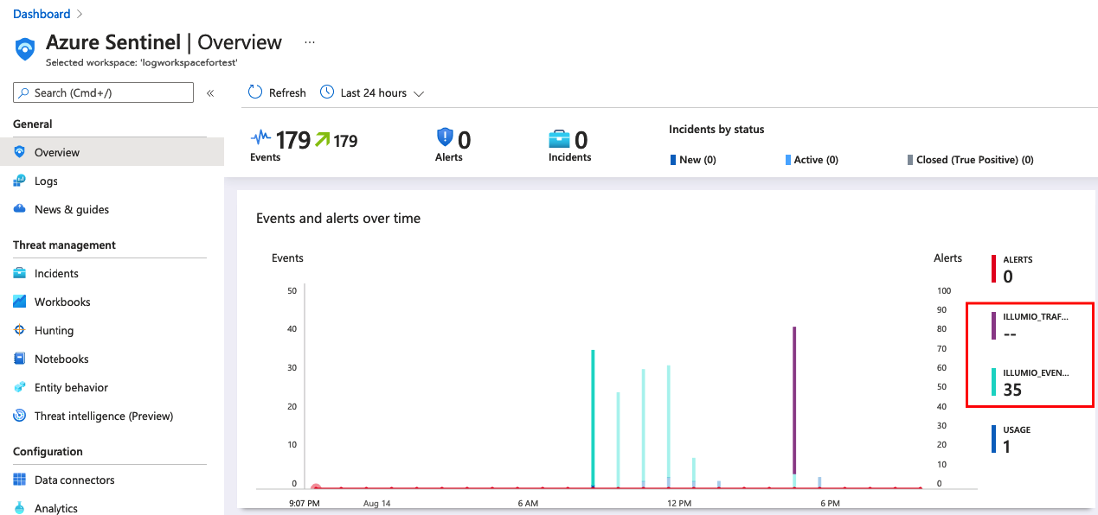
Basic Dashboard View on Azure Sentinel
Default Dashboard

Slide 38
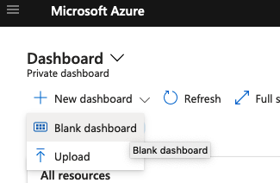
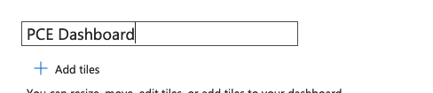
Custom Dashboard
Custom Dashboard

Slide 39
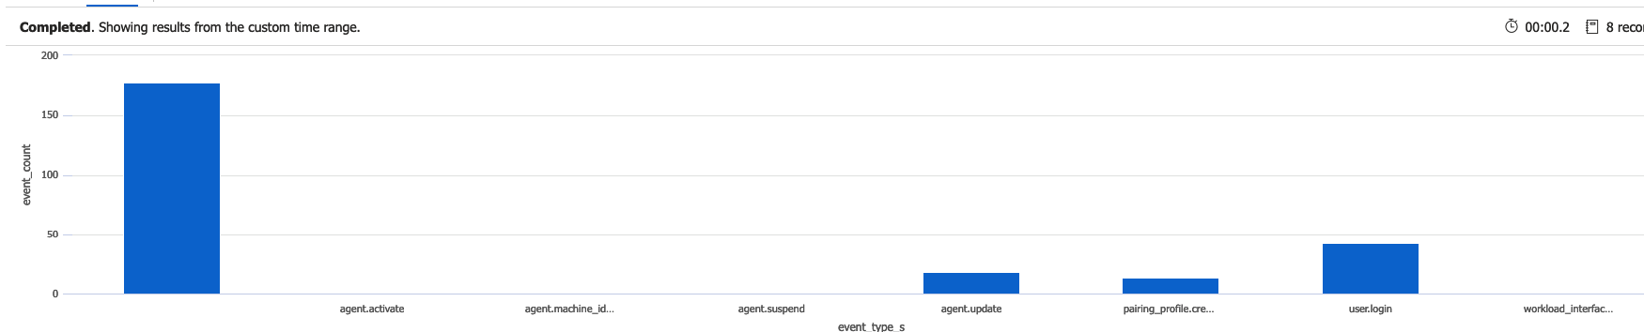
Sample Queries
Sample 1:
illumio_events_CL
| where event_type_s == "agent.activate”
Sample 2:
illumio_events_CL
| where event_type_s == "agent.update" and severity_s != "info"
| summarize event_count=count() by created_by_agent_hostname_s
| render timechart
Sample 3:
illumio_events_CL
| summarize event_count=count() by event_type_s
| sort by event_type_s asc
| render columnchart

Slide 40
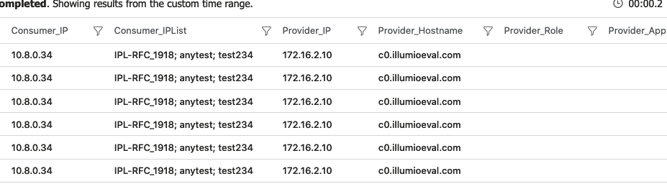
Traffic Data Query Sample 1
Consumer as IPList
illumio_traffic_CL // consumer as iplist
| project Flows = split(Message, ",")
| where isnotempty(Flows[1]) and Flows[1] != "Consumer IPList"
| mv-expand Consumer_IP=Flows[0], Consumer_IPList=Flows[1], Provider_IP=Flows[11], Provider_Hostname=Flows[14], Provider_Role=Flows[15], Provider_App=Flows[16], Provider_Env=Flows[17], Provider_Loc=Flows[18], Provider_FQDN=Flows[19], Transmission=Flows[20], Port=Flows[21], Protocol=Flows[22], Num_Flows=Flows[26], Connection_State=Flows[27], Reported_Policy_Decision=Flows[28], Reported_by=Flows[29], First_Detected=Flows[30], Last_Detected=Flows[31]

Slide 41
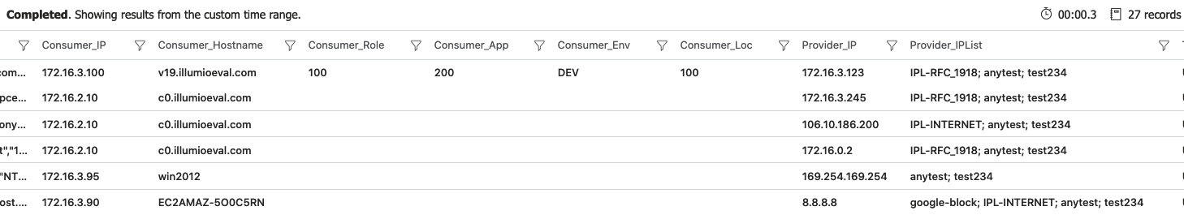
Traffic Data Query Sample 2
Provider as IPList
illumio_traffic_CL // provider as iplist
| project Flows = split(Message, ",")
| where isnotempty(Flows[12]) and Flows[12] != "Provider IPList"
| mv-expand Consumer_IP=Flows[0], Consumer_Hostname=Flows[3], Consumer_Role=Flows[4], Consumer_App=Flows[5], Consumer_Env=Flows[6], Consumer_Loc=Flows[7], Provider_IP=Flows[11], Provider_IPList=Flows[12], Transmission=Flows[20], Port=Flows[21], Protocol=Flows[22], Num_Flows=Flows[26], Connection_State=Flows[27], Reported_Policy_Decision=Flows[28], Reported_by=Flows[29], First_Detected=Flows[30], Last_Detected=Flows[31]

Slide 42
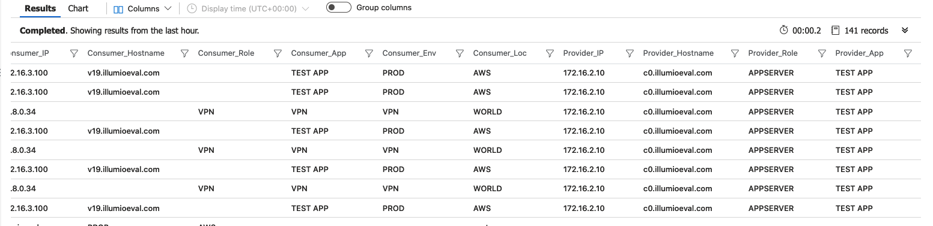
Traffic Data Query Sample 3
Both Groups
illumio_traffic_CL // group to group
| project Flows = split(Message, ",")
| where isempty(Flows[1]) and isempty(Flows[12])
| mv-expand Consumer_IP=Flows[0], Consumer_Hostname=Flows[3], Consumer_Role=Flows[4], Consumer_App=Flows[5], Consumer_Env=Flows[6], Consumer_Loc=Flows[7], Provider_IP=Flows[11], Provider_Hostname=Flows[14], Provider_Role=Flows[15], Provider_App=Flows[16], Provider_Env=Flows[17], Provider_Loc=Flows[18], Provider_FQDN=Flows[19], Transmission=Flows[20], Port=Flows[21], Protocol=Flows[22], Num_Flows=Flows[26], Connection_State=Flows[27], Reported_Policy_Decision=Flows[28], Reported_by=Flows[29], First_Detected=Flows[30], Last_Detected=Flows[31]

Slide 43
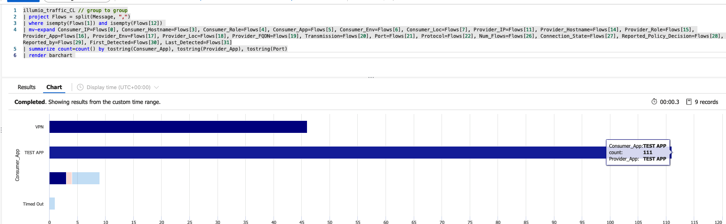
Traffic Data Query Sample 3
illumio_traffic_CL // group to group
| project Flows = split(Message, ",")
| where isempty(Flows[1]) and isempty(Flows[12])
| mv-expand Consumer_IP=Flows[0], Consumer_Hostname=Flows[3], Consumer_Role=Flows[4], Consumer_App=Flows[5], Consumer_Env=Flows[6], Consumer_Loc=Flows[7], Provider_IP=Flows[11], Provider_Hostname=Flows[14], Provider_Role=Flows[15], Provider_App=Flows[16], Provider_Env=Flows[17], Provider_Loc=Flows[18], Provider_FQDN=Flows[19], Transmission=Flows[20], Port=Flows[21], Protocol=Flows[22], Num_Flows=Flows[26], Connection_State=Flows[27], Reported_Policy_Decision=Flows[28], Reported_by=Flows[29], First_Detected=Flows[30], Last_Detected=Flows[31]

Slide 44
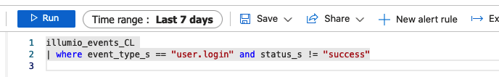
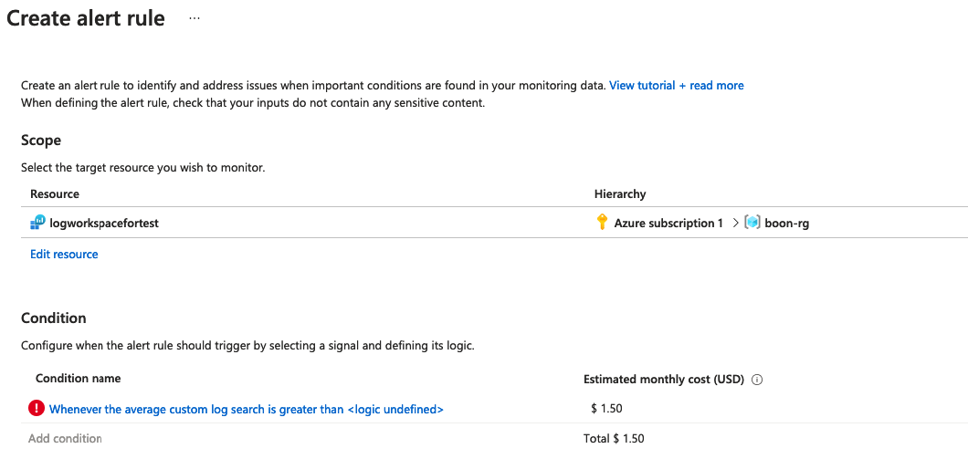
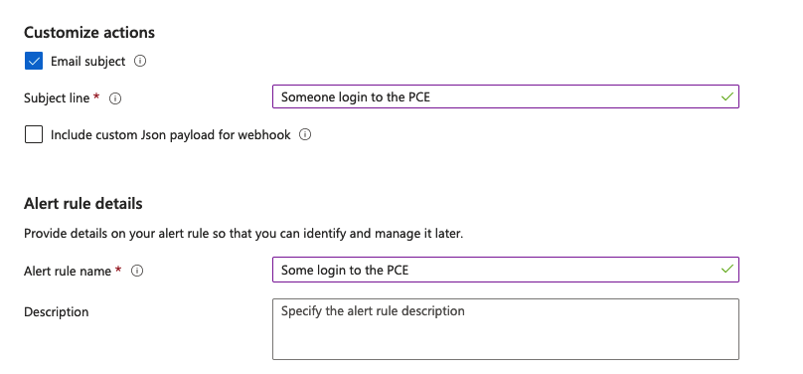
Alert

Slide 45
Thank you

